Slide 1
Magic: The Gathering
Online Pricing Analysis and Assessing Buy Signals
By: Davin Frankosky
Notes:
UNC Data Analytics Bootcamp - Project 4

Slide 2
Project Background

Slide 3
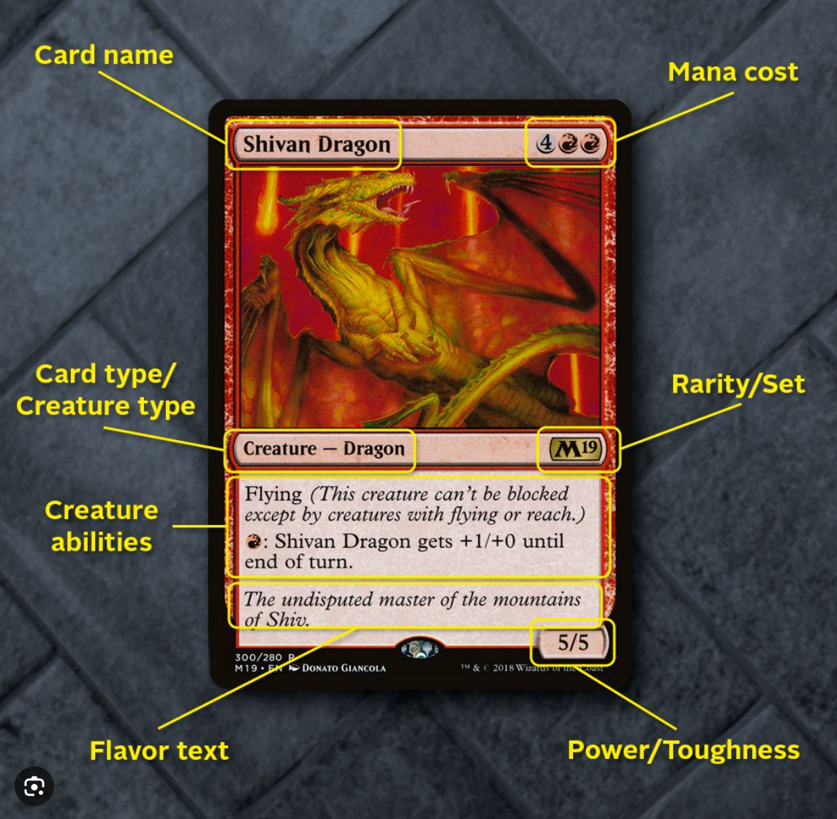
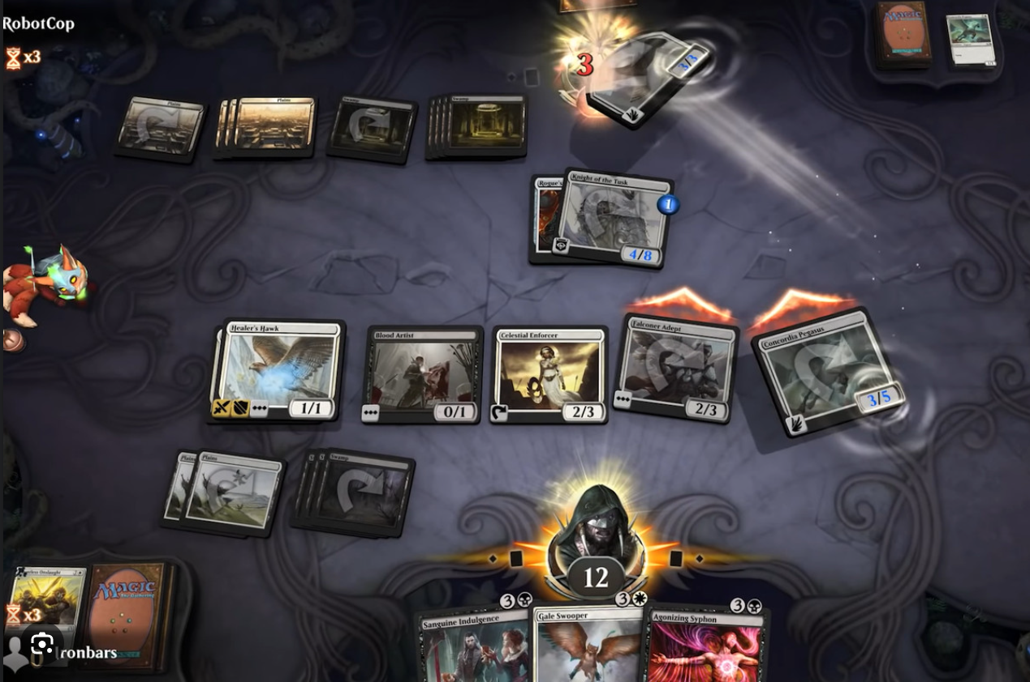
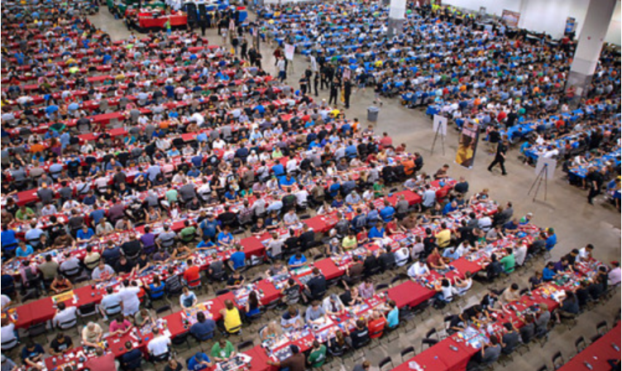
What is Magic: The Gathering (MTG)?
Opponents select cards from a large pool of options (thousands) to build a custom deck. The pool of options is defined by the ‘format’ being played.
Think Chess, but instead of pieces, there are cards and every card does something different. Some cards have unique interactions with others.
Decks must be at least 60 cards, and can only contain up to 4 copies of most cards. Objective is to get opponent’s life from 20 to 0.
Large tournament scene and economy.
Notes:
Imagine chess, except both choose their own unique collection of pieces to play with. Also, the pieces have abilities and interactions.
For example, imagine in chess if you had a knight that said “When this moves, your next pawn move can be in any direction”.
Cards have specific metadata

Slide 4
Dataset and Process – Summary from Project 3
Use Python to scrape card data from https://www.mtgo.com/decklists, (specifically format leagues) for all of January 2024. These are all decks that went 5-0.
Use Python scripts to combine JSON data on card pricing from https://www.goatbots.com/.
Build dataframes in Python (format, date of tournament, total number of copies of each card, card name)
Push this info to a Postgres SQL database.
Pull data from my Database using Tableau for Visualizations.

Slide 5
Why?
Metagame analysis: Highlight trends in the tournament scene to better inform deckbuilding decisions.
Continue to build out functionality for a fun hobby and share with friends!
Potentially discover investment opportunities for emerging cards.

Slide 6
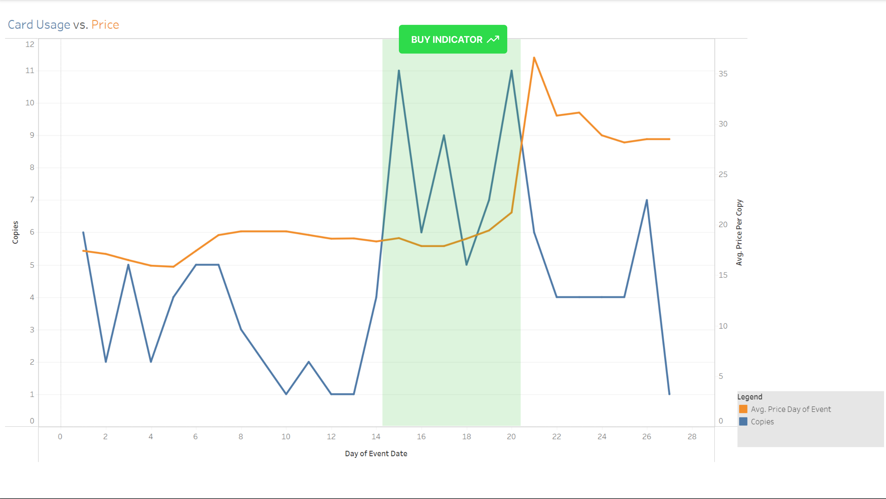
Investigation into Pricing
Vendors sell cards on Magic the Gathering: Online via bots
Tournament usage of cards heavily influences their sales price
Price updates regularly lag changes in tournament usage volume
~6 days to buy in!
Notes:
Tournament results are posted daily
Card prices are readily available at all times.

Slide 7

Hypothesis
For any specific card, multiple events in a row where the usage is higher than the previous week's average number of copies triggers a buy signal if the price does not show a significant fluctuation.
This sent me researching moving averages models and models designed to work with time-series data.

Slide 8
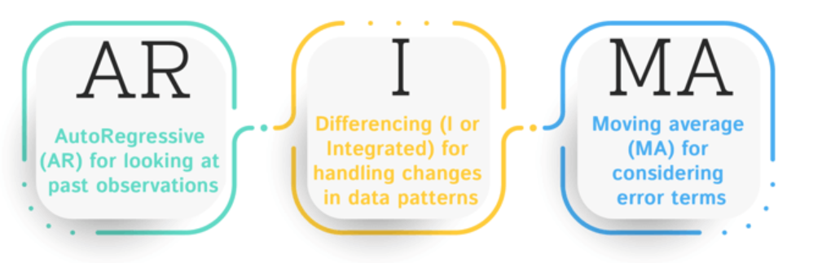
ARIMA: Autoregressive Integrated Moving Average
Popular statistical approach for time series forecasting. This model is designed to describe and predict future points in a series based on its own past values (autoregression), the differencing of raw observations (integrated part) to make the time series stationary, and the forecasting errors of past time points (moving average).
Strengths:
Short to Medium-Term Forecasting
Stationary Series
Non-Seasonal Data
Used in Financial Markets
Common in Production and Sales Forecasting

Slide 9
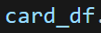
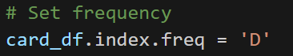
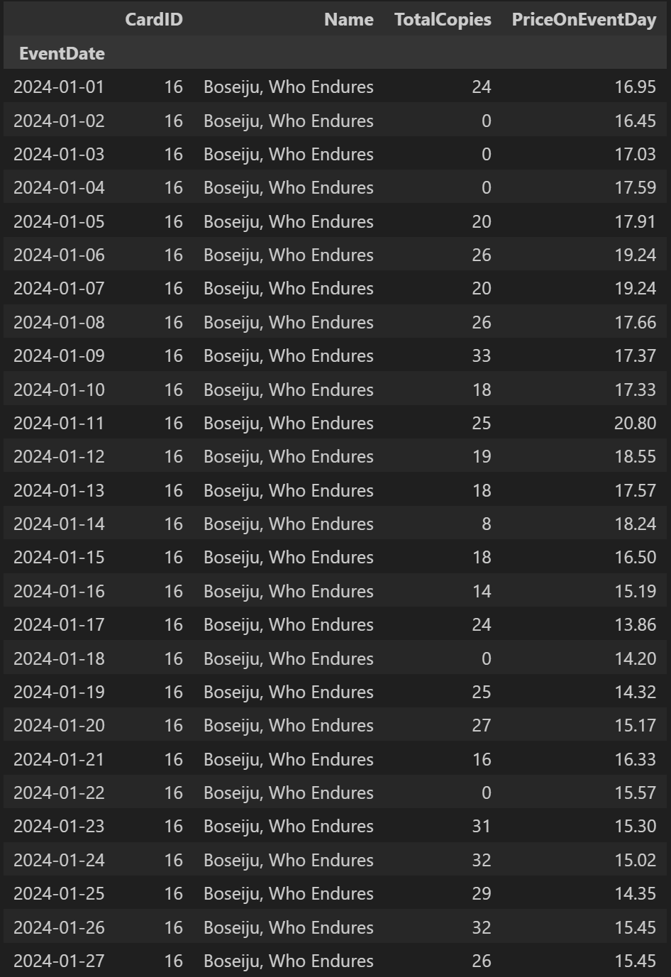
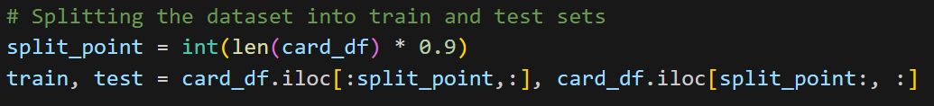
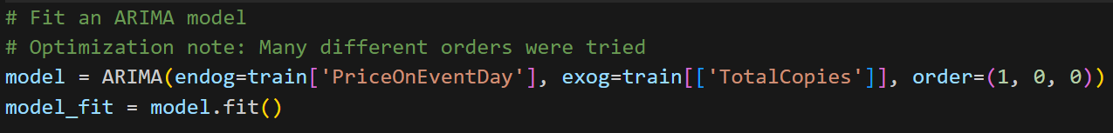
Applying the Model - Example
Set “daily” frequency
Train on first 90% of the data, test against the remaining 10%
Notes on exogenous variables and the order argument next slide
Apply the model to forecast
Compare the forecast to the remaining data (results to follow)

Slide 10
Exogeneous Variables and Order
A variable that originates outside the model and is not influenced by the variables within the model.
I infer that a card’s usage in tournaments is independent of its price. This is generally true in high-level Magic play.
Use this variable to explain/predict the dependent variable (price).
order = (p, d, q)
p: Autoregressive (AR) order. p = 1 means the model includes one lagged value.
d: Differencing order. This indicates how many times the data have been differenced to achieve stationarity. (Differencing is a method to remove trends or seasonal structures).
q: Moving Average (MA) order. This represents the number of lagged forecast errors included in the model. (This component helps capture the shock or surprise elements in the past forecast errors)
Notes:
Another example of an exogeneous variable might be umbrella pricing. An increase in rainy weather may influence an umbrella’s price, but an umbrella’s price is not going to influence the weather.

Slide 11
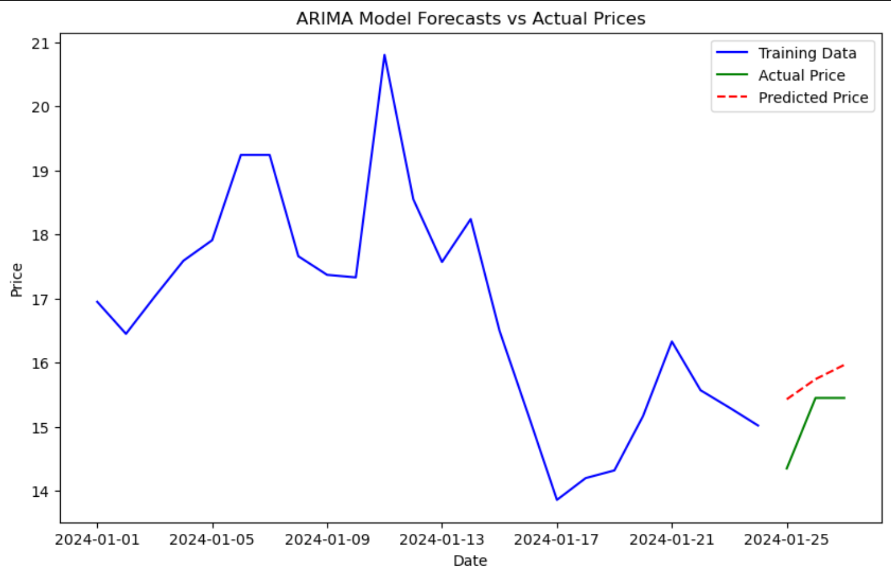
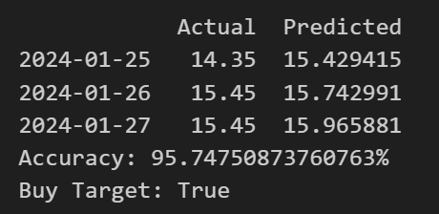
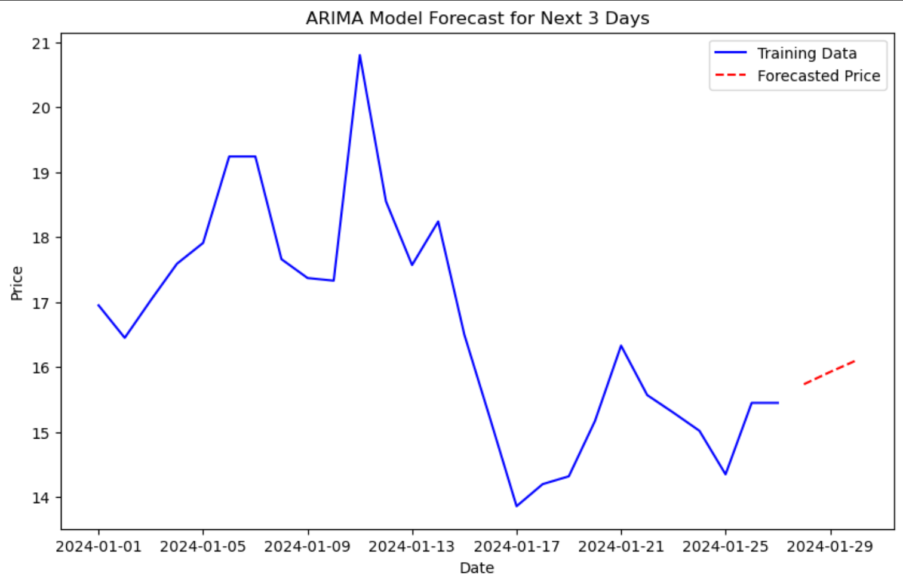
Example Result
Accuracy: Calculated via Mean Absolute Percentage Error, or mape.
Buy Target: if the max predicted price is higher than the final day price of the training data, return True.

Slide 12
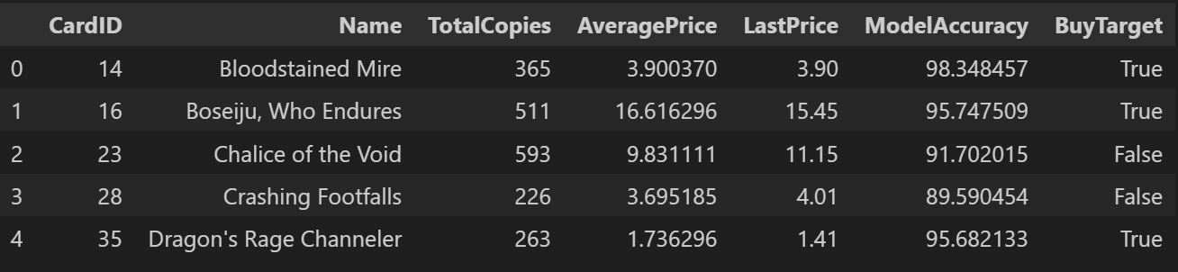
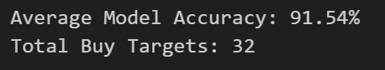
Build to Scale
Apply the data to every card in my dataset, with a few caveats:
Limit to 1 format, for simplicity
Remove cards with average price less than $1 from the dataset
Use on somewhat commonly played cards (total copies across the month of January > 100).

Slide 13
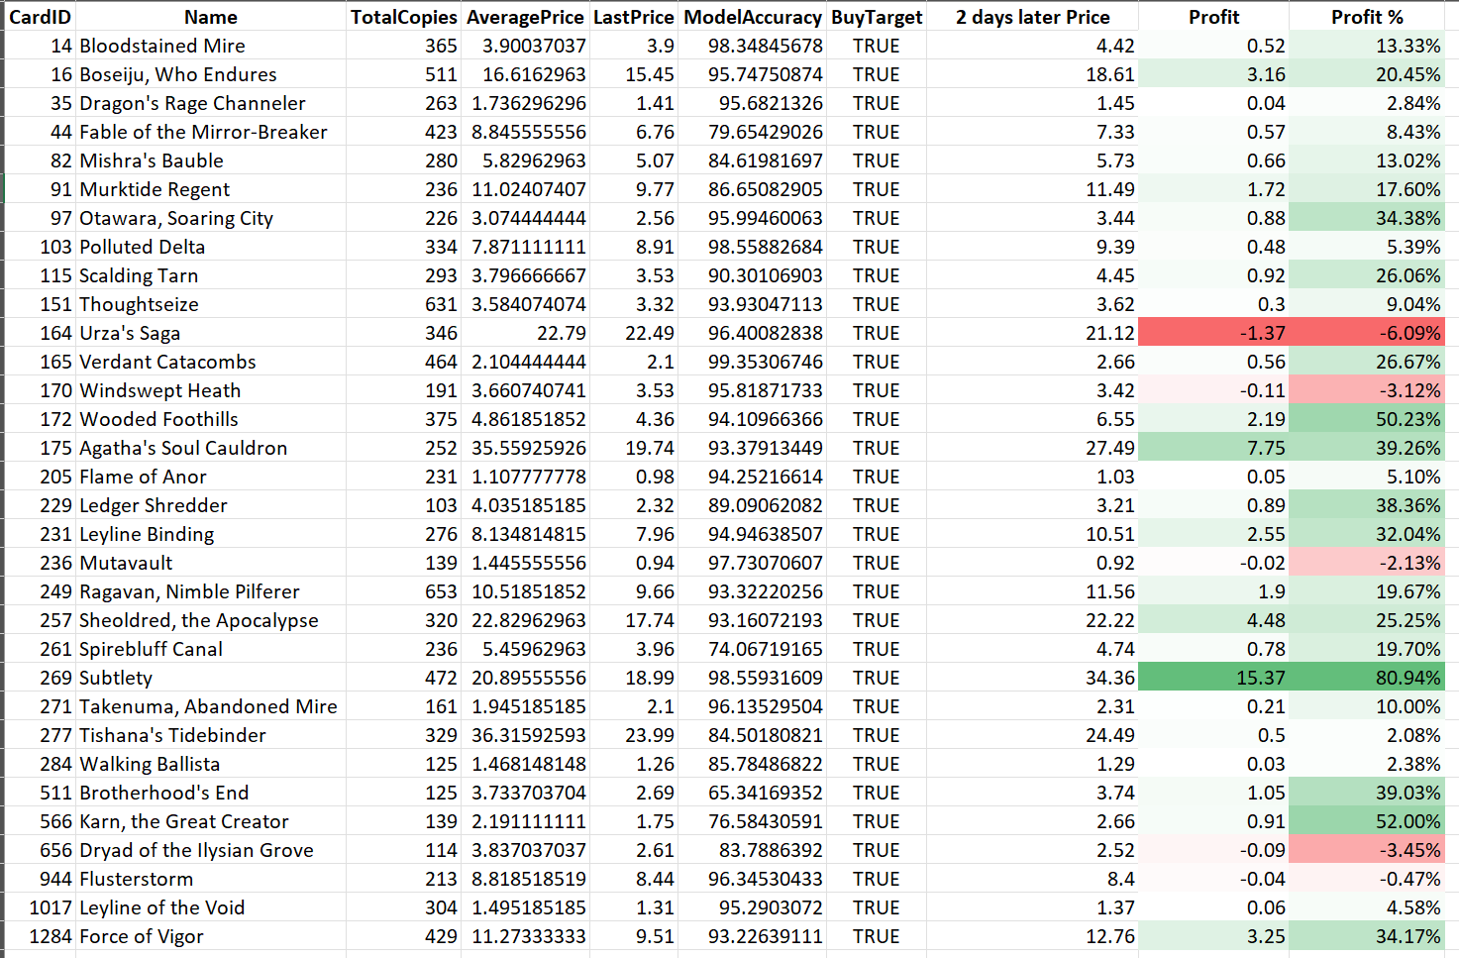
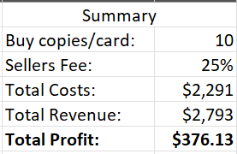
Real World Application
Trained on data from 1/1/24 to 1/27/24.
Used the model to give buy targets for 3 days in the future.
Pulled the list prices from 1/30/24, and calculated theoretical profits if I had “day traded” what the model suggested.
Profit!

Slide 14
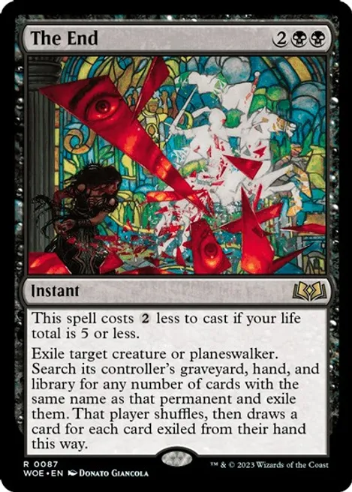
Questions?

Slide 15
Appendix

Slide 16
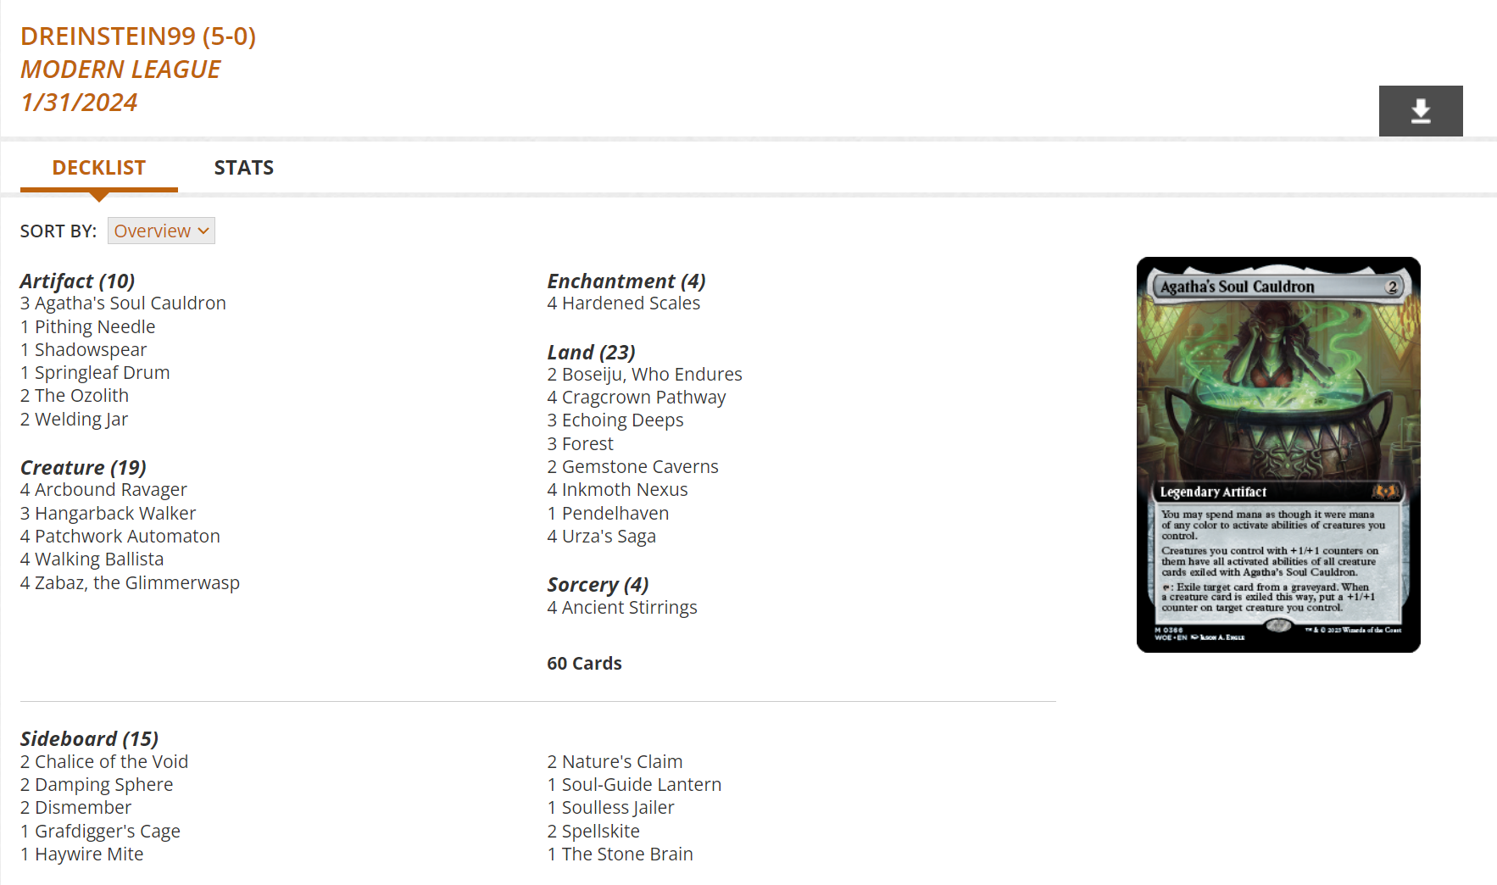
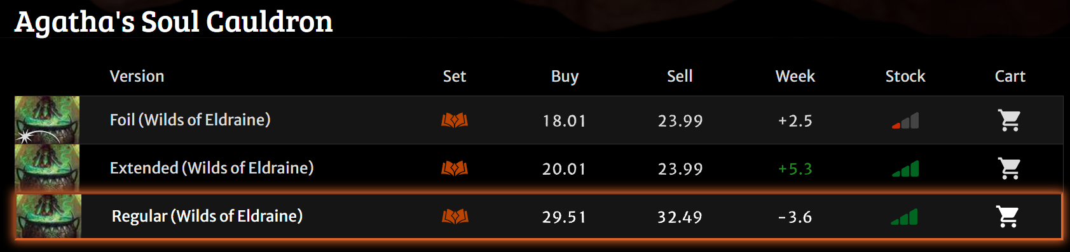
Tournament, Card, and Pricing Data
Results from tournaments held on Magic: The Gathering Online (MTGO) are publicly available on https://www.mtgo.com/decklists.
Bots buy and sell cards on MTGO. Goatbots.com is one of the largest dealers, and they generally set the market for card valuation.
Card metadata available through the MTG API: https://docs.magicthegathering.io/

Slide 17
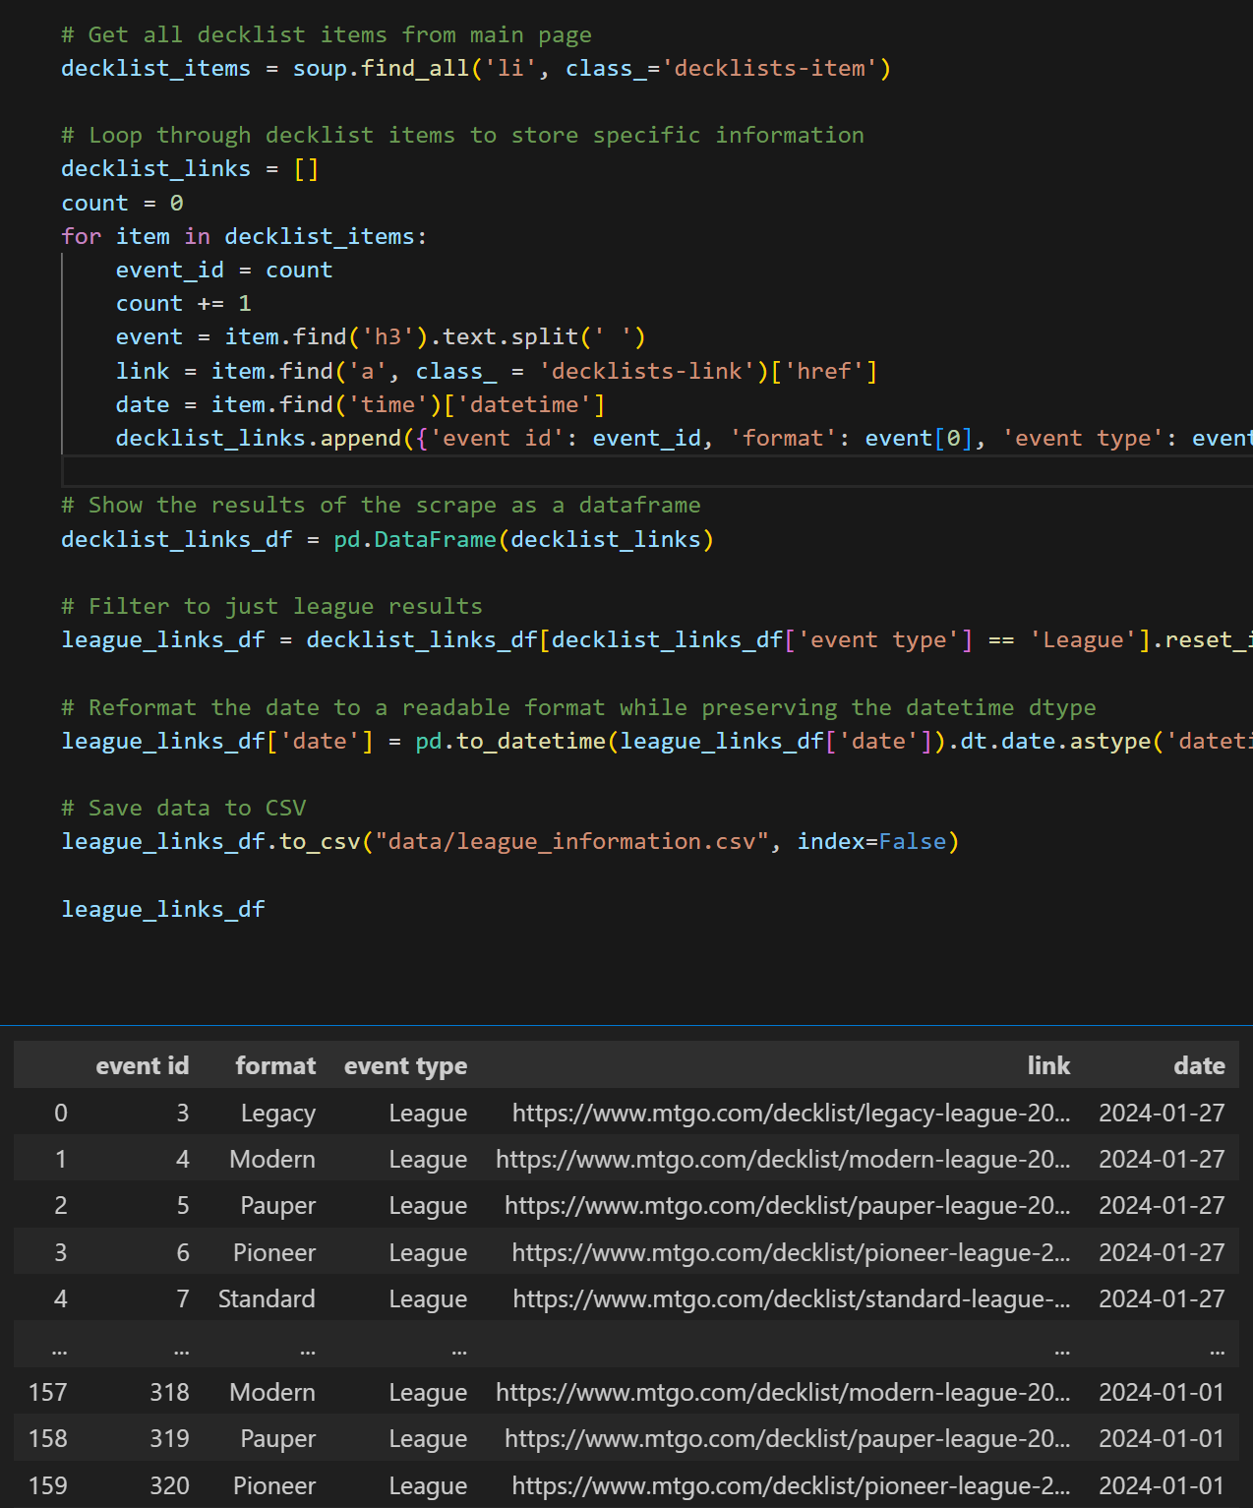
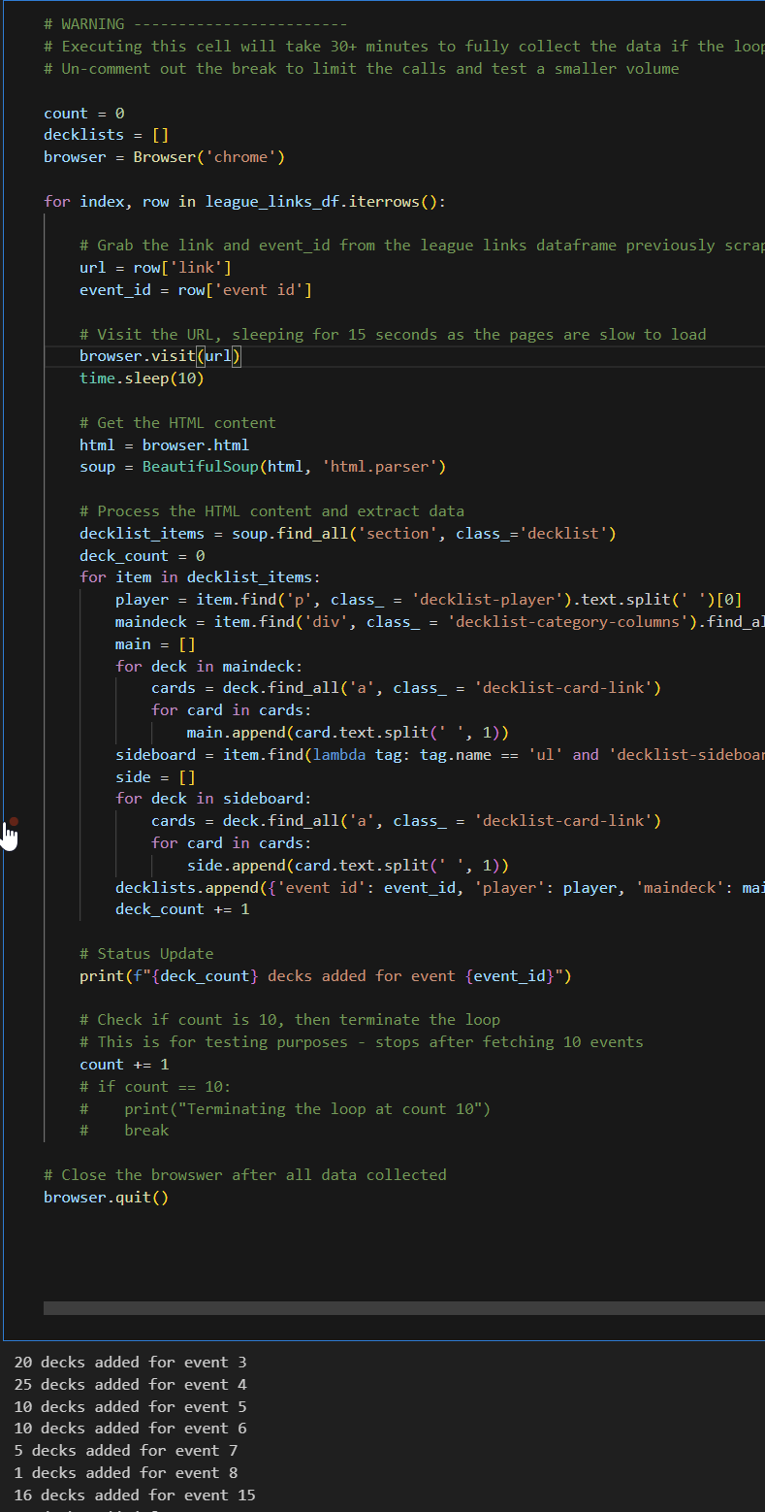
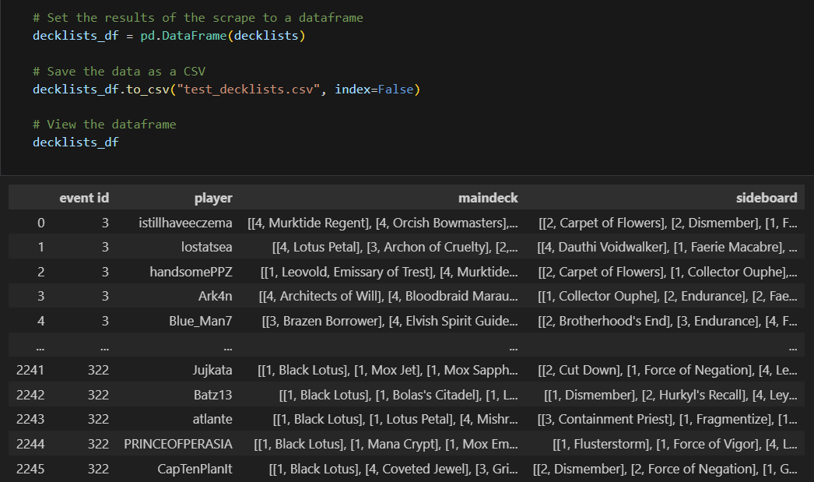
Dataset and Process
1 - Data Scraping
Use Python with BeautifulSoup to scrape decklist data from https://www.mtgo.com/decklists for January 2024 YTD. These are all decks that went 5-0, and establishes the metagame.
Build dataframes in Python with Pandas with event, deck, and card information.
Keep in mind unique IDs to be used as primary keys later across tables.
Loop through each tournament event
Store decklists as a list for each event

Slide 18
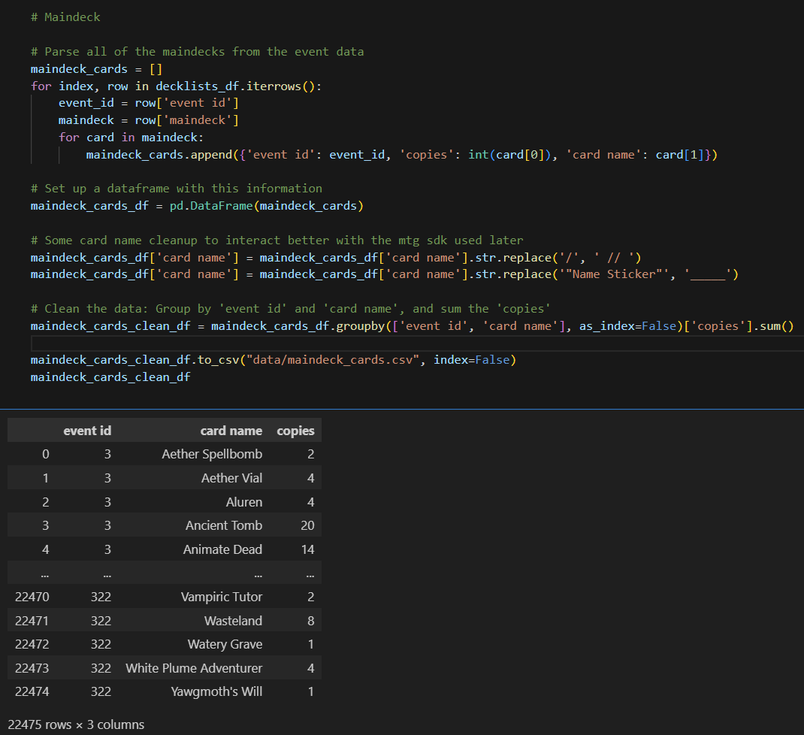
Dataset and Process
2 - Decklist Cleaning
Parse out each card and the number of copies.
Had to return to this a number of times once I started interacting with the MTG API for card information due to discrepancies in card name formatting.
Loop through each deck
Notes:
Note: As a future project, I need to use the eventID and player name to create another unique ID: Deck ID. The way this project is done now, after data cleaning, I don’t have number of decks in a given event to show format popularity.

Slide 19
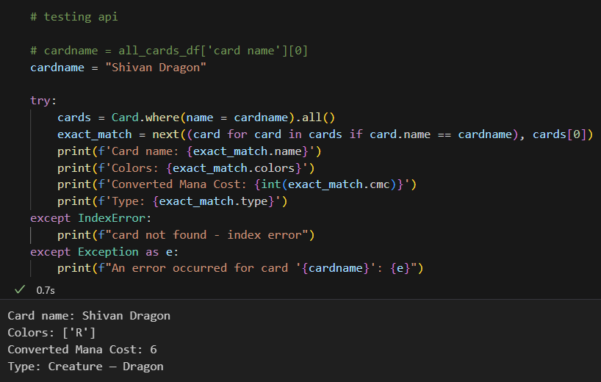
Dataset and Process
3 - API Testing - Retrieve Card Metadata
Use the MTG API via Python package mtgsdk.

Slide 20
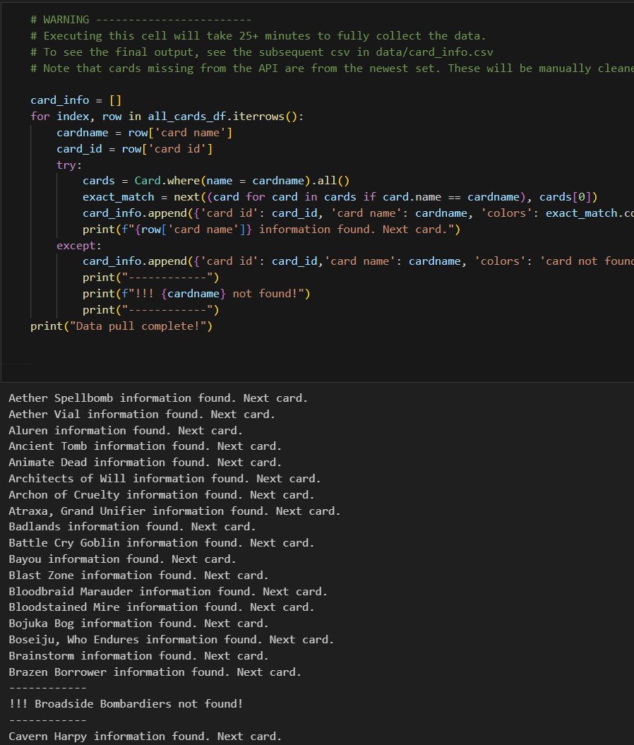
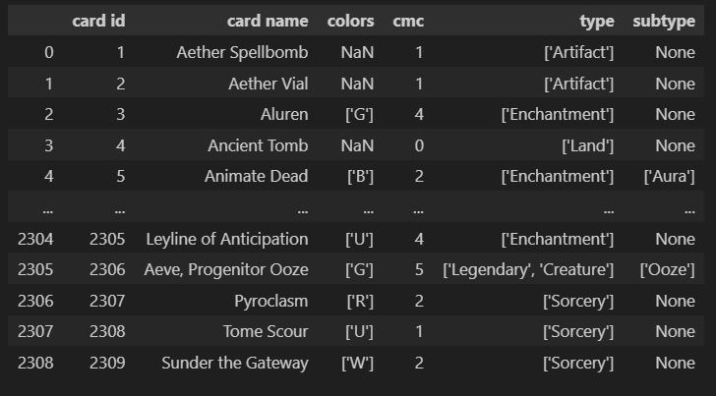
Dataset and Process
4 - Store Card Metadata
Loop through all cards and use the API to store their metadata in more dataframes.
Manually filled in some gaps as some very new cards were not in the API.
List-ify cards with multiple attributes

Slide 21
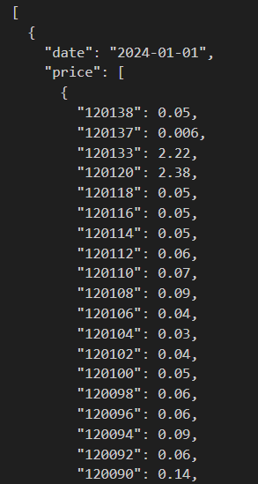
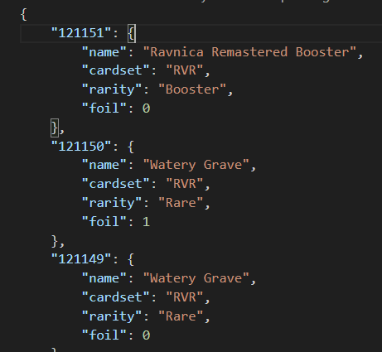
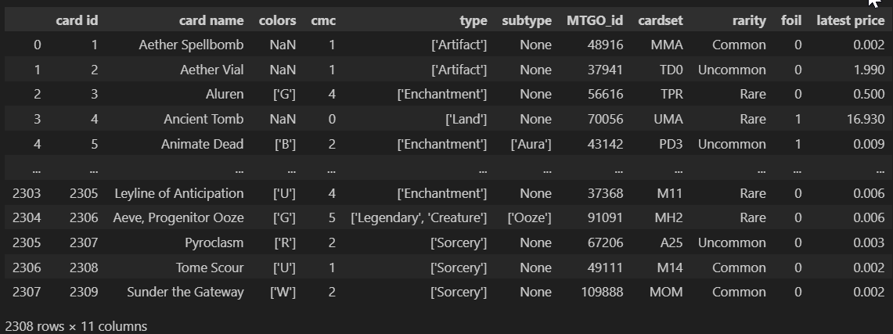
Dataset and Process
5 - Import Pricing Information
Daily pricing history from goatbots.com. Wrote a python script to collate these into a master JSON file with date, card ID, and price keys.
Multiple versions exist for each card name on MTGO, each with a different price. Synced my card ID with the MTGO ID of the lowest priced version for this project.
Notes:
If I were to redo it, I would have worked backwards from the pricing spreadsheet and used their MTGO_ID as my Primary key throughout!

Slide 22
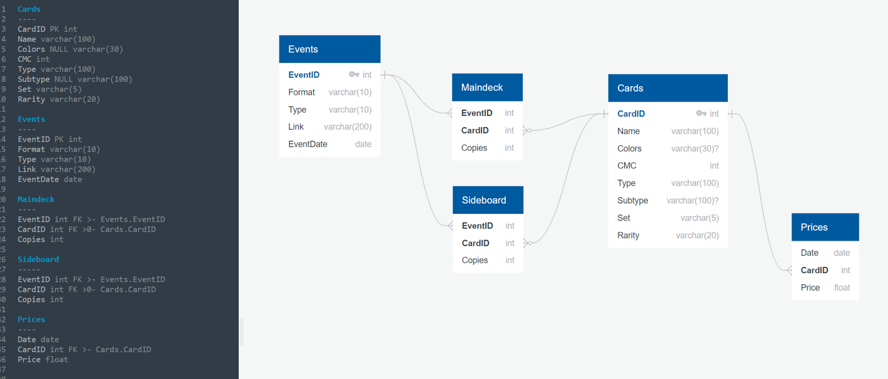
Dataset and Process
6 - Set up SQL Database
SQL is chosen because my dataset is very consistent and well defined: Every card has virtually the same set of non-ambiguous metadata.
Notes:
Events have Decks, Decks have Cards, Cards have Prices

Slide 23
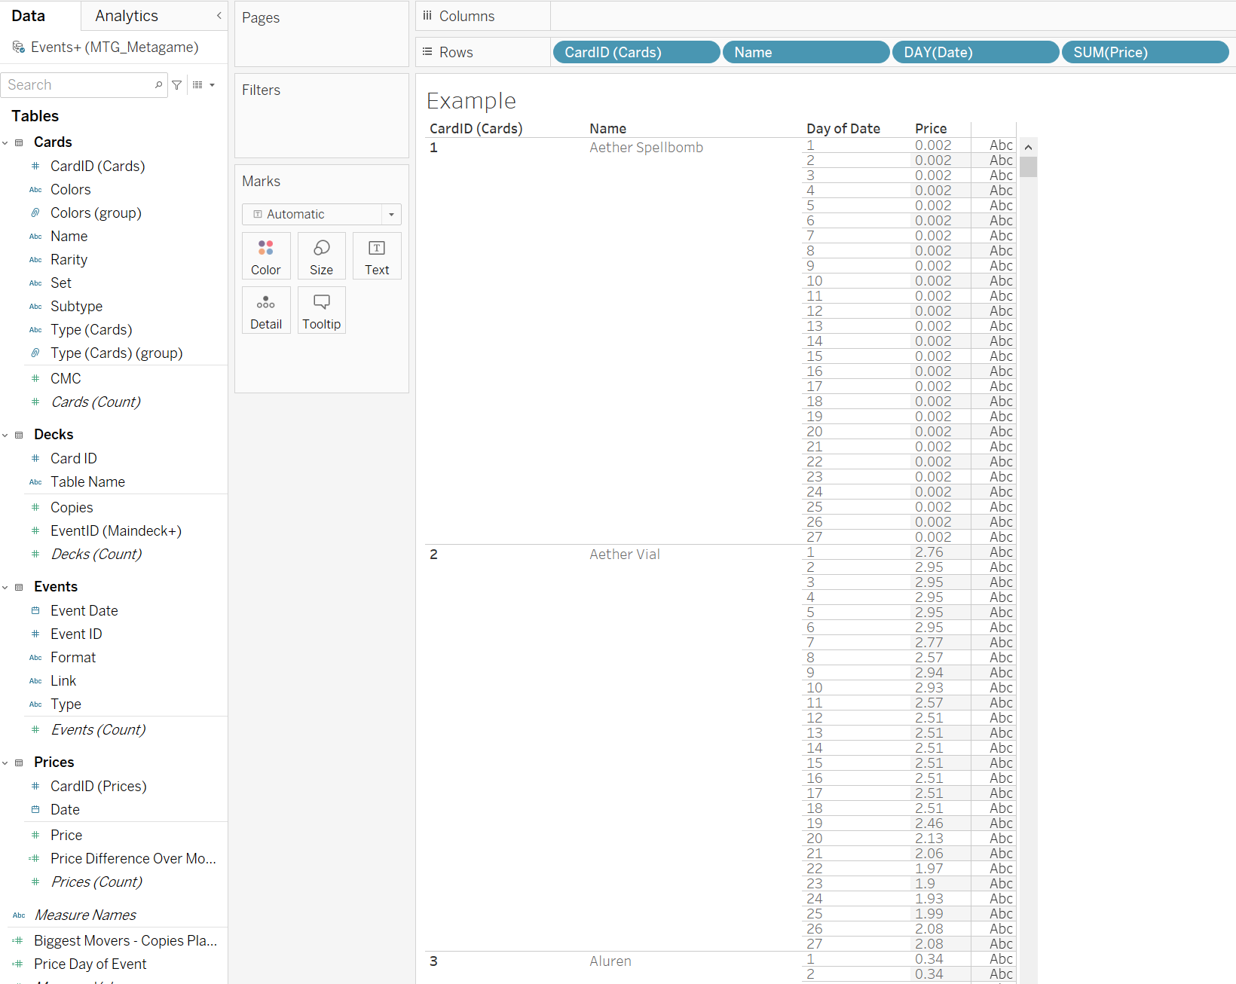
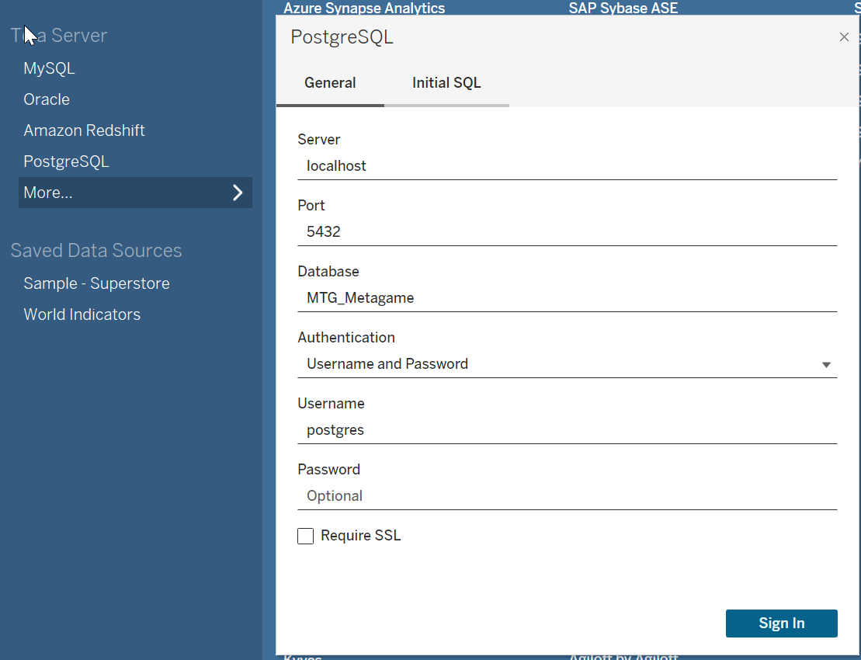
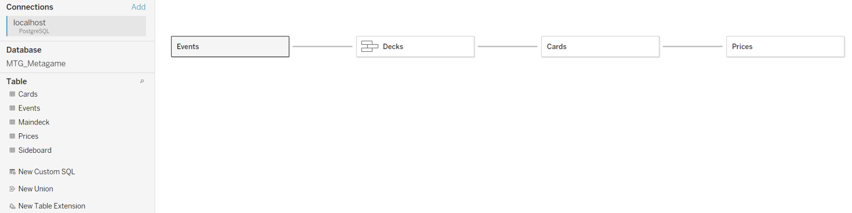
Dataset and Process
7 - Connect to Tableau
Connect my PostgreSQL Database to Tableau for visualizations
Manipulate Data
Connect
Relate Tables

Slide 24
Visualizations

Slide 25
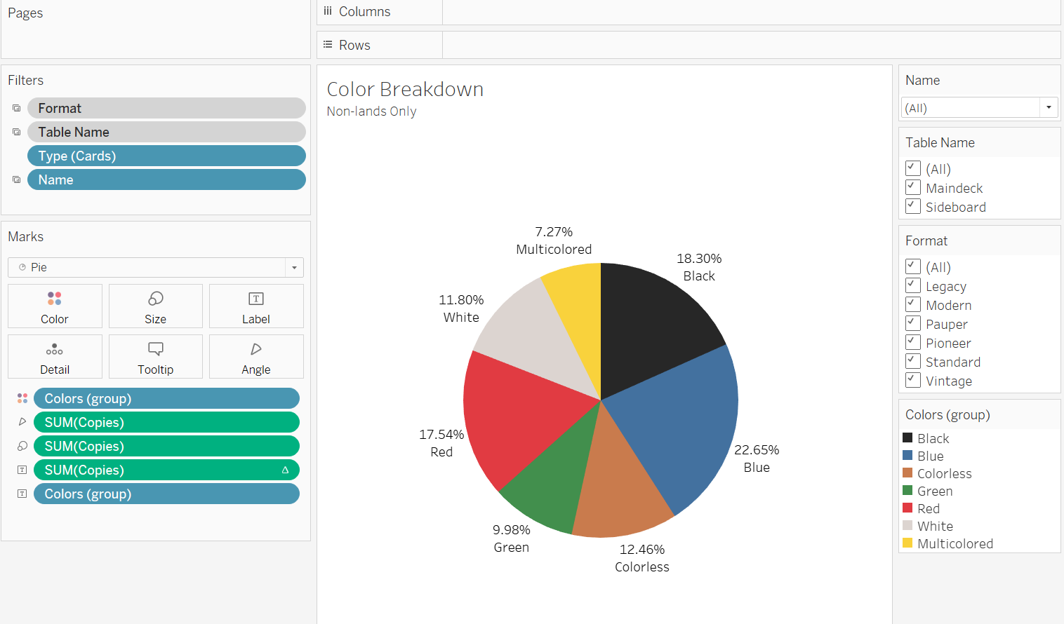
Visualizations
1 - Create Visualizations
Use tables and filters to plot data
User friendly drag-and-drop functionality

Slide 26
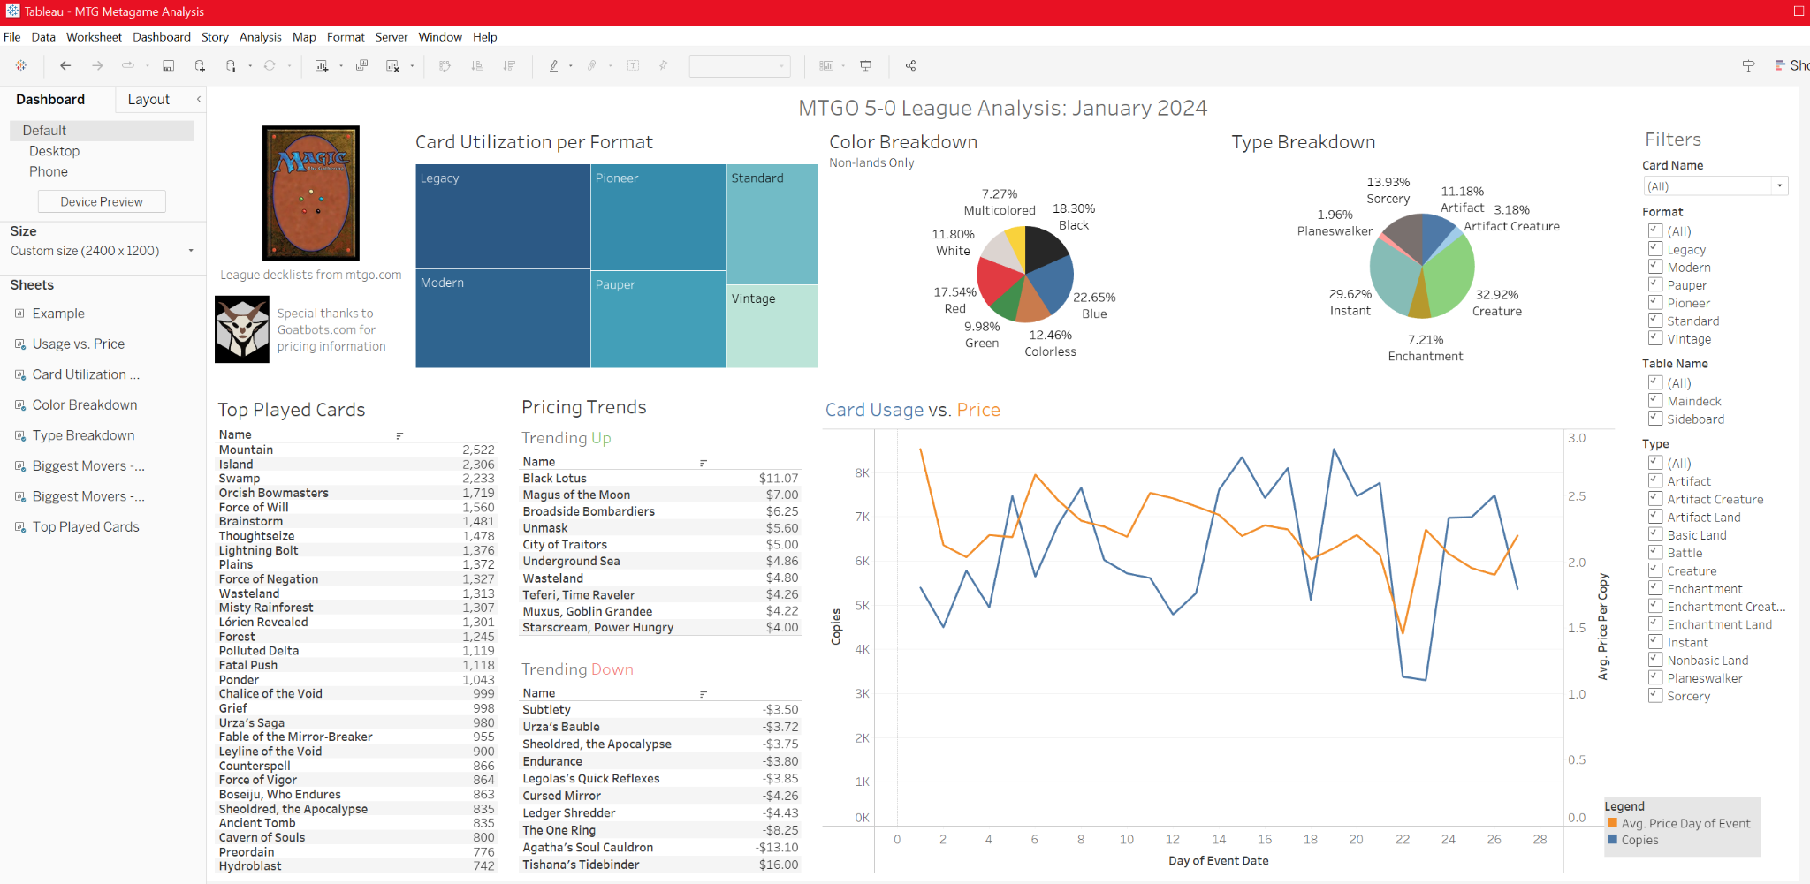
Visualizations
2 - Collate to Central Dashboard

Slide 27
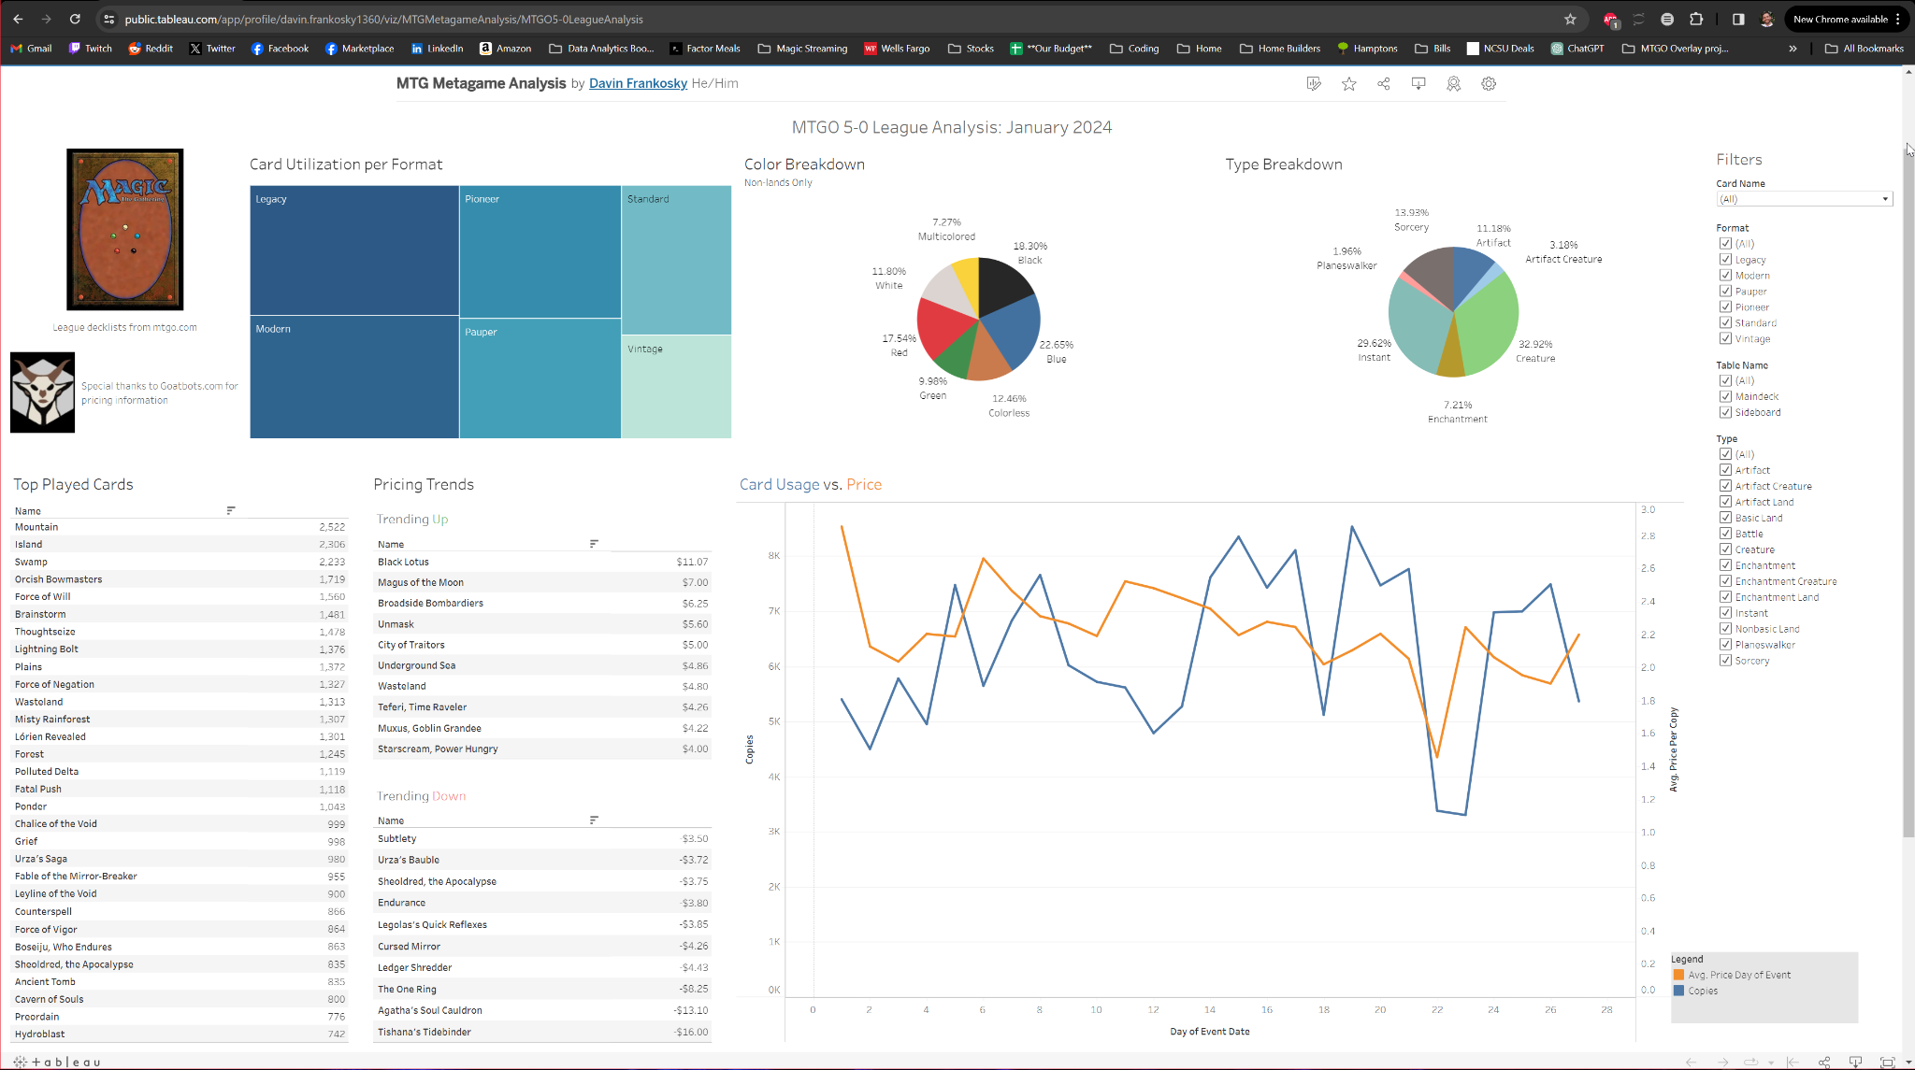
Visualizations
3 - Publish to Tableau Public

Slide 28
Live Demo

Slide 29
Ethical Considerations

Slide 30
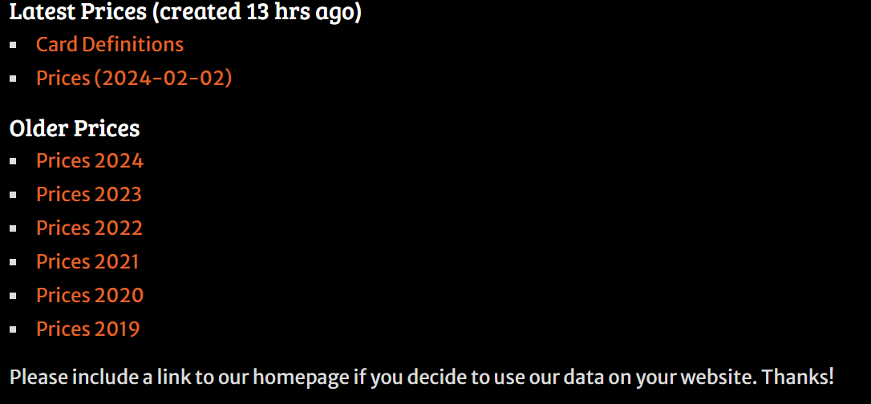
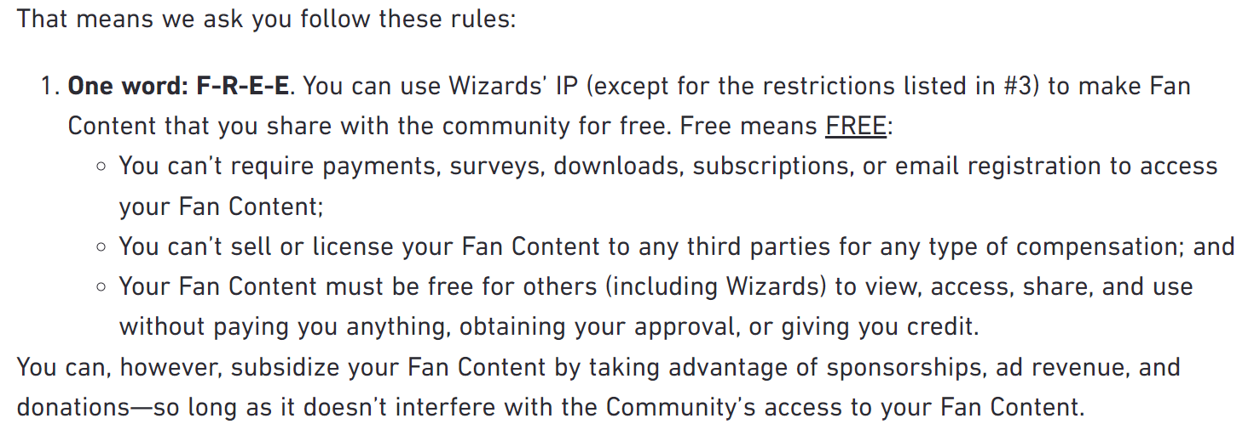
Ethical Considerations
Cite sources, give credit:
Avoided displaying Personally Identifiable Information (PII)
Follow MTG API rate limits and reference the MTG SDK MIT free use license.
Follow Wizards of the Coast Fan Content policy

